Slide 1
SeattleSTAY AI
Topic Modeling on Airbnb Reviews

Slide 2

Introduction
Seattle Airbnb reviews hold valuable insights into guest experiences.
Manual analysis is inefficient due to the massive volume of reviews.
SeattleStay AI leverages NLP & advanced topic modeling to uncover hidden patterns and actionable themes

Slide 3




Objectives
CLEAN AND PREPROCESS AIRBNB REVIEW TEXT
EXTRACT DOMINANT THEMES USING LDA, NMF, BERTOPIC
COMPARE INTERPRETABILITY, COHERENCE, AND TOPIC RICHNESS
VISUALIZE RESULTS AND PROVIDE ACTIONABLE INSIGHTS

Slide 4
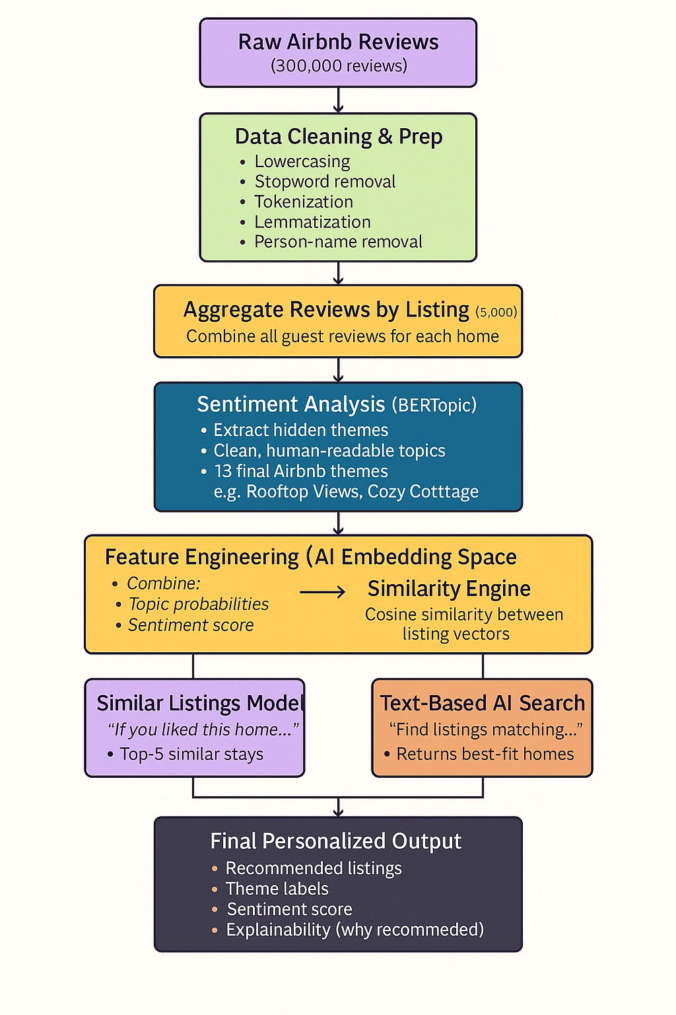
WorkFlow
Diagram

Slide 5
DataSet Overview
Reviews dataset: comments, listing_id, date
Listings dataset: name, description, neighborhood_overview, amenities
541,092 reviews after cleaning
Removed null and short reviews (<20 chars)
Prepared for tokenization and lemmatization

Slide 6

Preprocessing Steps
Text Normalization: Convert text to lowercase and remove special characters.
Noise Reduction: Eliminate punctuation, numbers, and extra spaces.
Tokenization: Split reviews into individual words for analysis.
Stopword Removal: Remove common and custom Airbnb-specific stopwords.
Lemmatization: Reduce words to their base form for consistency.
Filtering: Drop empty or very short reviews (<20 characters).
Notes:
In our preprocessing pipeline, we first normalize the text by converting everything to lowercase and removing special characters. Then we reduce noise by eliminating punctuation, numbers, and extra spaces. Next, we tokenize the reviews into individual words and remove common and Airbnb-specific stopwords. After that, we lemmatize the words to bring them to their base form. Finally, we filter out empty or very short reviews. These steps clean and standardize the data, making it ready for topic modeling.

Slide 7
LSA
What is LSA?
Latent Semantic Analysis (LSA) is a technique in Natural Language Processing (NLP) that uses Singular Value Decomposition (SVD) to reduce the dimensionality of text data.
LSA
Latent Semantic
Analysis
It captures hidden relationships between words and documents by mapping them into a lower-dimensional semantic space.
Unlike simple keyword matching, LSA identifies concepts and patterns based on word co-occurrence.
Notes:
LSA, or Latent Semantic Analysis, is a technique that reduces text data into a smaller semantic space using SVD. It helps uncover hidden relationships between words and documents and identifies concepts based on how words co-occur—not just simple keyword matching.

Slide 8
Why LSA?
Improves semantic understanding: Finds related terms even if exact words differ.
Reduces noise: Handles synonymy and polysemy better than raw term frequency.
Efficient representation: Converts large sparse matrices into compact form for modeling.
Notes:
LSA helps improve semantic understanding by finding related terms even when wording differs. It reduces noise by handling synonyms and multiple meanings better than basic term counts. And it creates an efficient, compact representation of the text, making modeling faster and more effective.

Slide 9
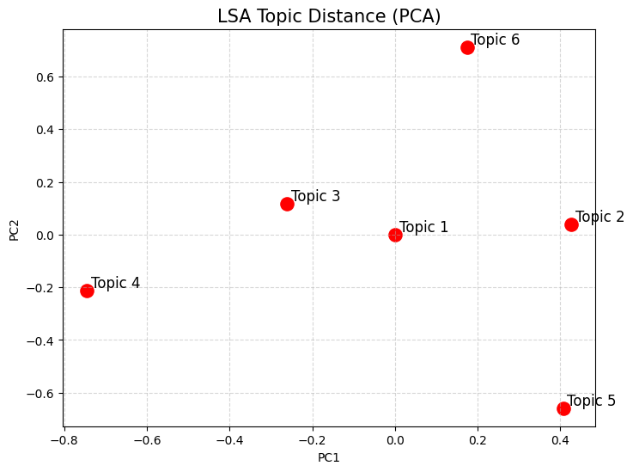
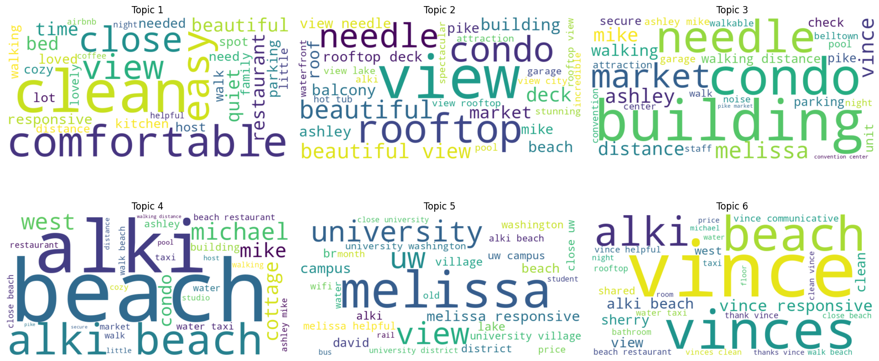
LSA WORD CLOUD
Notes:
THEN WE HAVE THE WORD CLOUD FOR lsa. this PCA plot shows how LSA topics differ from each other in semantic space. Topics that appear closer share similar word patterns, while those farther apart represent distinct themes. For example, Topic 6 is the most unique, whereas Topics 1, 2, and 3 are more related.

Slide 10
LSA Model - Key Topics
Topic 1: General positive experience
Top words: clean, comfortable, easy, close, view, beautiful
Topic 2: Good host & location value
Top words: view, rooftop, condo, needle, beautiful, beauty
Topic 3: Highly recommended stay
Top words: building, condo, needle, market, melissa, vince
Topic 4: Clean and comfortable space
Top words: beach, alki, alki beach, michael, west, mike
Topic 5: Friendly & responsive host
Top words: melissa, view, uw, university, melissa responsive
Topic 6: Relaxing and quiet stay
Top words: vince, vinces, beach, alki, vince responsive
Notes:
These five LDA topics summarize the major themes in Airbnb reviews. We see clusters around walkable downtown convenience, cozy and comfortable stays, essential amenities and host interaction, scenic views, and family-friendly spacious homes. Each topic is defined by the most frequent and meaningful words used by guests.

Slide 11
LSA
What is LDA?
Latent Dirichlet Allocation (LDA) is a generative probabilistic model for discovering hidden topics in large text corpora.
LDA
Latent Dirichlet Allocation
LDA uses Bayesian inference to assign probabilities of topics to words and documents.
Unlike simple keyword matching, LSA identifies concepts and patterns based on word co-occurrence.
It assumes each document is a mixture of topics, and each topic is a distribution over words.

Slide 12
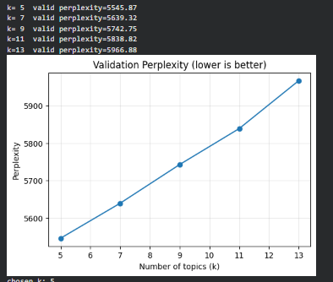
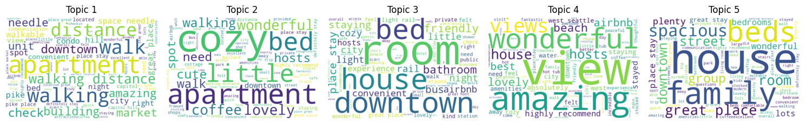
Ideal Number of topic & LDA Word Cloud

Slide 13
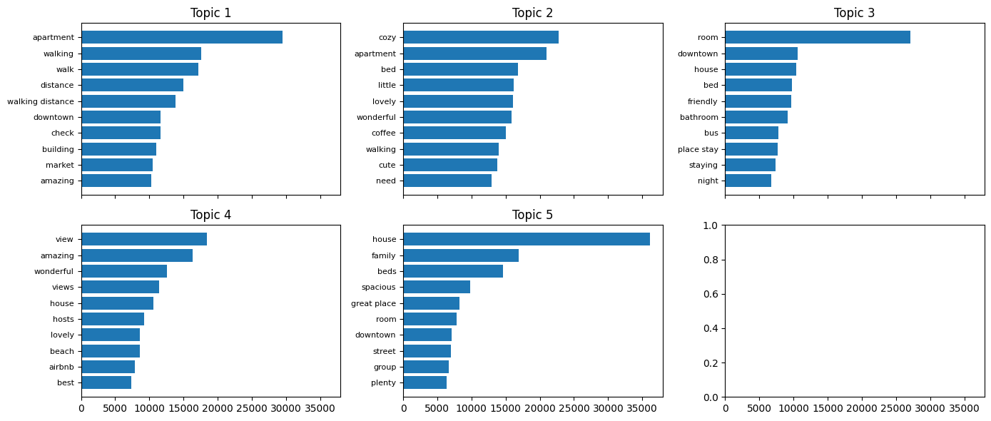
Top words per Topic

Slide 14
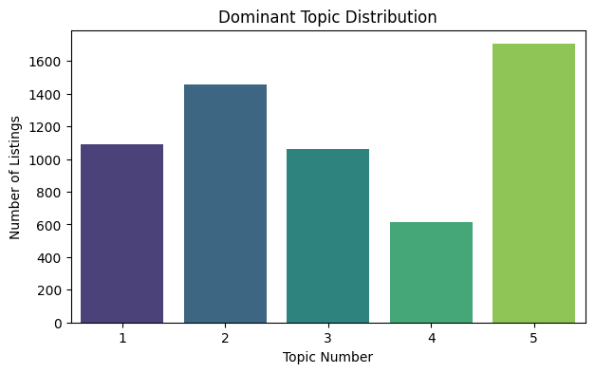
LDA Model - Key Topics
Topic 1: Walkable Downtown Convenience:
apartment, walking, walk, distance, downtown, market, clean
Topic 2: Cozy and Comfortable Stays:
cozy, bed, little, lovely, wonderful, coffee, cute, walking
Topic 3: Stay Essentials and Host Interaction:
room, friendly, bathroom, staying, bus, place stay, downtown
Topic 4: Scenic Views and Memorable Experience:
view, amazing, wonderful, hosts, beach, airbnb, lovely
Topic 5: Family Friendly and Spacious Homes:
house, family, beds, spacious, great place, group, room

Slide 15
LSA
What is NMF?
Non-negative Matrix Factorization (NMF) is a dimensionality reduction technique.
NMF
Non-Negative Matrix Factorization
Key constraint: All entries in V, W, H are non-negative.
It factorizes a non-negative matrix V into two smaller non-negative matrices:
Unlike simple keyword matching, LSA identifies concepts and patterns based on word co-occurrence.

Slide 16




Why NMF?
Interpretability: Non-negativity leads to parts-based representation (e.g., images broken into meaningful components).
Dimensionality Reduction: Reduces large datasets into smaller, interpretable factors.
Applications:
Text mining (topic modeling)
Image processing (feature extraction)
Recommendation systems (collaborative filtering)
Advantages over PCA: NMF does not allow negative values, making results easier to interpret in real-world contexts.

Slide 17
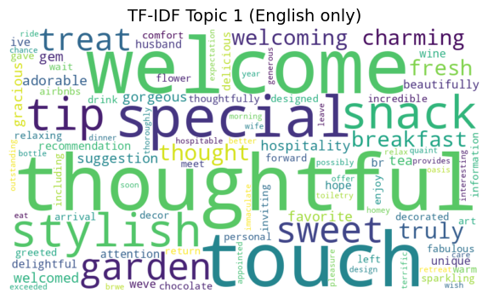
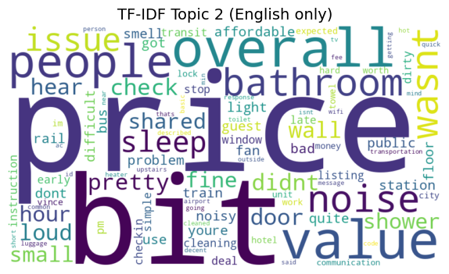
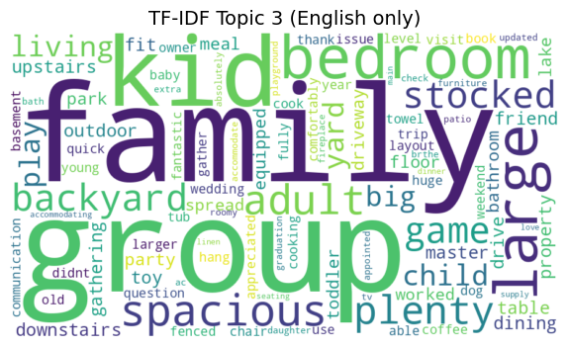
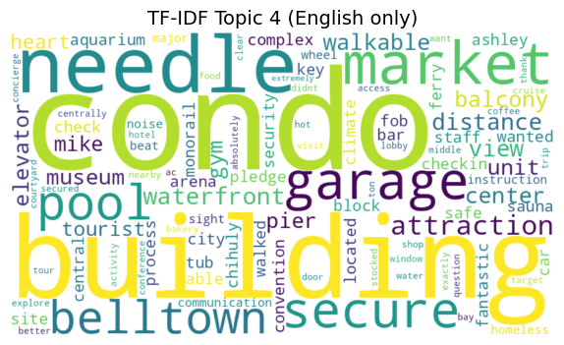
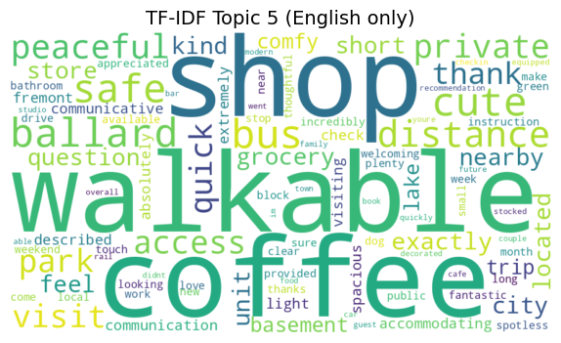
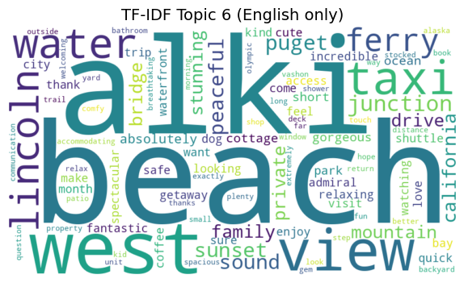
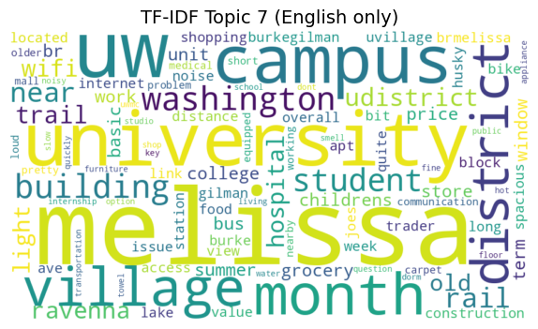
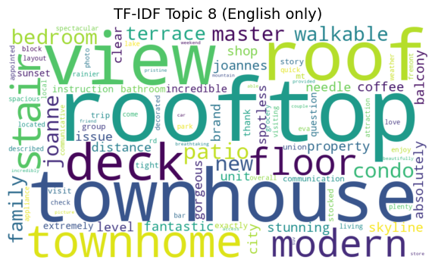
NMF WORD CLOUD

Slide 18
NMF Model - Key Topics
Topic 1: clean, comfortable, easy, quiet, close, bed, responsive, time, needed, beautiful
Topic 2: view, beautiful, rooftop, deck, family, beach, roof, lake, loved, group
Topic 3: building, condo, clean, market, needle, walking, restaurant, parking, walk, distance
Topic 4: melissa, uw, university, campus, clean, building, close, br, village, district
Topic 5: vince, vinces, clean, responsive, bathroom, night, shared, easy, unit, bed

Slide 19
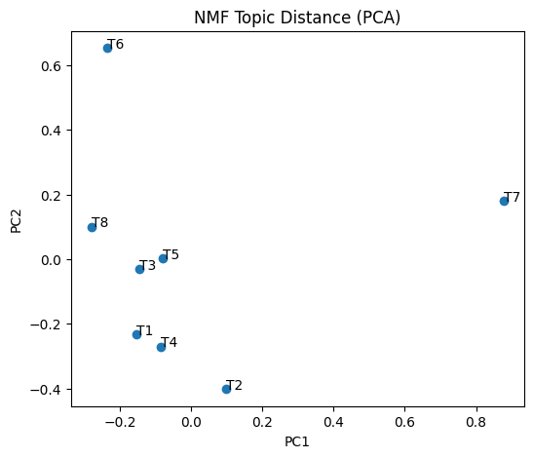
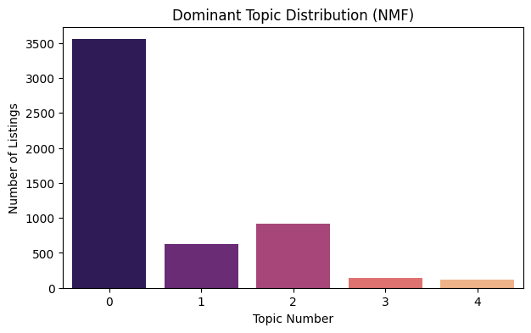

Slide 20
LSA
What is BERTopic?
BERTopic is a topic modeling technique that uses BERT embeddings and clustering to discover topics.
BERTopic
Ideal for short texts and nuanced language like Airbnb reviews.
Unlike simple keyword matching, LSA identifies concepts and patterns based on word co-occurrence.
Unlike traditional models, it captures semantic meaning and contextual relationships between words.

Slide 21
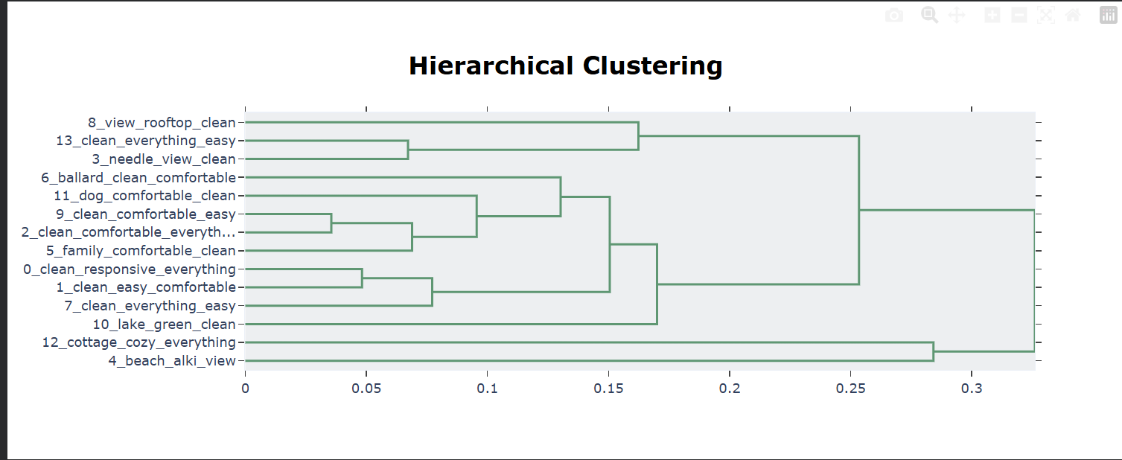

Slide 22
Top BERTopic Themes for Seattle Airbnb Reviews
Cleanliness & Responsive Hosts
Convenient, Easy Stay Essentials
Calm and Comfortable Stays
Family-Friendly Homes with Space
Rooftop, Views, and Deck Experience
Walkability & Space Needle Access
Ballard Neighborhood Experience
Beach & Alki Waterfront Stays
Quiet Stays with Parking Ease
Bedroom Comfort & Interior Quality
Pet-Friendly Stays
Cozy Cottage Experience

Slide 23
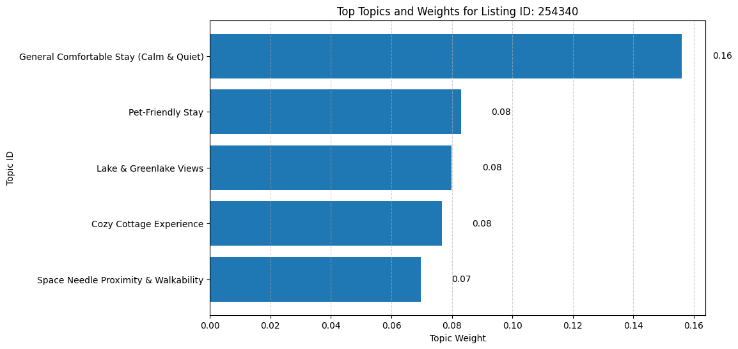
Top 5 Review Themes for Listing ID: 254340
Guests highlight its calm stay, pet-friendly setup, lake views, cozy cottage feel, and walkable location.

Slide 24
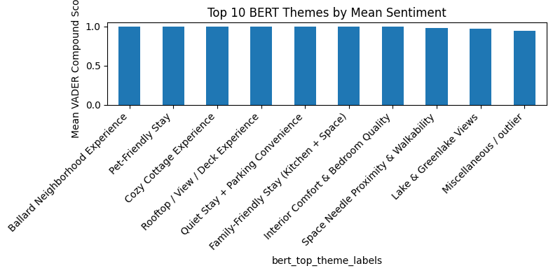
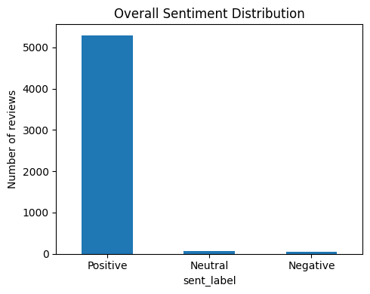
BERTopic - Sentiment Summary

Slide 25
Comparative Summary
Interpretability: LDA > NMF > BERTopic
Topic richness: BERTopic > LDA > NMF

Slide 26



AI Recommendation Model:
Three Types of Recommendations We Provide
Listing-to-Listing Similarity Based on shared review themes.
Search-to-Listing Recommendations Matches user text preferences to listings.
Positive-Filtered Listing Recommendations Similar listings but only with strong sentiment.

Slide 27
AI Recommends Listings Based on Shared Review Themes
Matches listings with highly similar guest-experience themes for listing id: 254340
listing_id | name | Sentiment_ label
17787304 | Charming 1910 Craftsman: Private Room for up to 3 | Positive
7922663 | Beautiful View RM#2 | Positive
6.28325E+17 | Seward Park Retreat with Open Floor Plan 1 Bedroom | Positive
25725786 | Old Apple Trees Guest House | Positive
20029802 | Latona Guest Suite with Office, A/C and Parking | Positive

Slide 28
AI Search-by-Experience: Matching Listings to User Descriptions
AI reads what the user wants and finds the listings with the closest guest-experience profile.
listing_id | name | sentiment_label
1.27191E+18 | SLU Stylish 1 King Suite City View | Neutral
47047526 | Blueground | S. Lake Union, parking, nr dining | Neutral
1.12178E+18 | Beautiful View Ravenna Apartment | Neutral
7.42772E+17 | Home Away from home, 1bdrm, private entrance. | Neutral
1.01461E+18 | CityView by Urban Upscale (Garden Level Studio) | Neutral

Slide 29
Positive-Filtered Similar Listings
High-quality recommendations based on both theme similarity and positive sentiment.
listing_id | name | sentiment_label
17787304 | Charming 1910 Craftsman: Private Room for up to 3 | Positive
7922663 | Beautiful View RM#2 | Positive
6.28325E+17 | Seward Park Retreat with Open Floor Plan 1 Bed... | Positive
25725786 | Old Apple Trees Guest House | Positive
20029802 | Latona Guest Suite with Office, A/C and Parking | Positive

Slide 30
Business Insights
Budget listings: focus on value and basics
Luxury listings: emphasize views and unique experiences
Hosts can improve cleanliness and responsiveness
Airbnb can align pricing with guest sentiment

Slide 31



Conclusion
SEATTLESTAY AI TRANSFORMS UNSTRUCTURED REVIEWS INTO ACTIONABLE INSIGHTS
HELPS HOSTS OPTIMIZE LISTINGS AND IMPROVE GUEST EXPERIENCE
FUTURE SCOPE: SENTIMENT ANALYSIS, PERSONALIZATION

Slide 32
Thank you
Any questions?
Ask away!

